Slide 1
Facebook Website UI Redesign
A Human-Computer Interface (HCI) Study
Module: HCI3202 HUMAN COMPUTER INTERFACE
Session: JUN 2026
Programme: BITI – BACHELOR OF INFORMATION TECHNOLOGY
Section: 6MB1
Faculty: Kala Devi Managuran
Student Name: Shahadat Hossain
ID: I26041279
1

Slide 2
Table of Contents
1.0 Introduction
2.0 User Experience (UX) Research
2.1 User Behaviours and Attitudes
2.2 Analysis for All Research Methods
2.3 Hypothesis Formulation
3.0 Interaction Design
3.1 Prototype Screenshots and Navigation
3.2 Content Delivery – Conceptual Design
3.3 Interactive Features
4.0 Usability Testing
4.1 Participants
4.2 Survey Scope and Results
4.3 Evidence of Conduct
Conclusion
References
Section B: Prototype
2

Slide 3
1.0 Introduction
• Facebook has 3.07 billion monthly active users (DataReportal, 2025)
• Minor UX issues affect millions of users daily
• This HCI study evaluates Facebook website interface satisfaction
• Nine core pages tested: Login, Registration, Home Feed, Profile, Friend Request, Message, Notifications, Settings Pages
• 30 respondents surveyed via Google Forms
• Quantitative results used to validate redesign in Figma
• Follow-up survey conducted with same 30 respondents for usability testing
3

Slide 4
2.0 User Experience (UX) Research
• Target Audience: Young adults (18–35), university students & working professionals
• 30 respondents aged 19–26, daily/weekly Facebook web users
• Website Goal: Connect & communicate with friends, family, communities
• Core functions: Profile building, friendship network, post sharing, messaging, notifications, personalized feed
• Research Method: Structured close-ended questionnaire via Google Forms
• Three questions per page: Satisfaction, Primary Problem, Preferred Change
4

Slide 5
2.1 User Behaviours and Attitudes – Personas
Persona 1: Md Arif Mahmud Oyion
Persona 2: Chia Kim Hua
Persona 3: Md Sadek Hosen
• Age 23, INTI International University
• Daily user (laptop/web)
• Dissatisfied: Registration, Home Feed, Friend Request
• Pain point: Interruptions during browsing
• Age 21, INTI International University
• Weekly user
• Neutral: Registration (unclear errors)
• Pain point: Confusing moments due to infrequent use
• Age 24, AI University-Bangladesh
• Rare user
• Dissatisfied: Registration, Friend Requests, Notifications
• Pain point: Most sensitive to friction
5

Slide 6
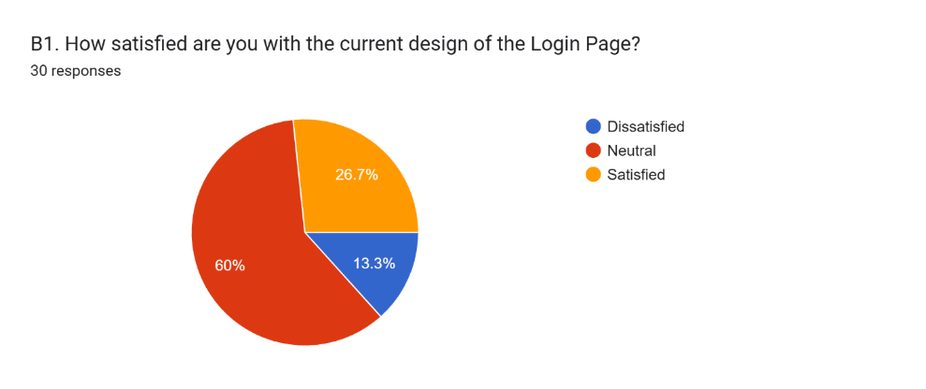
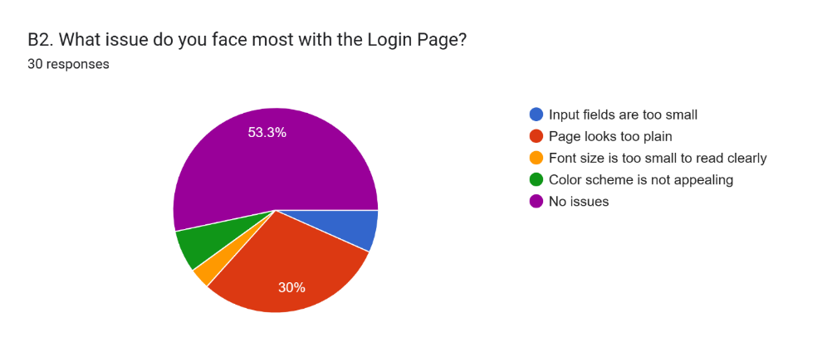
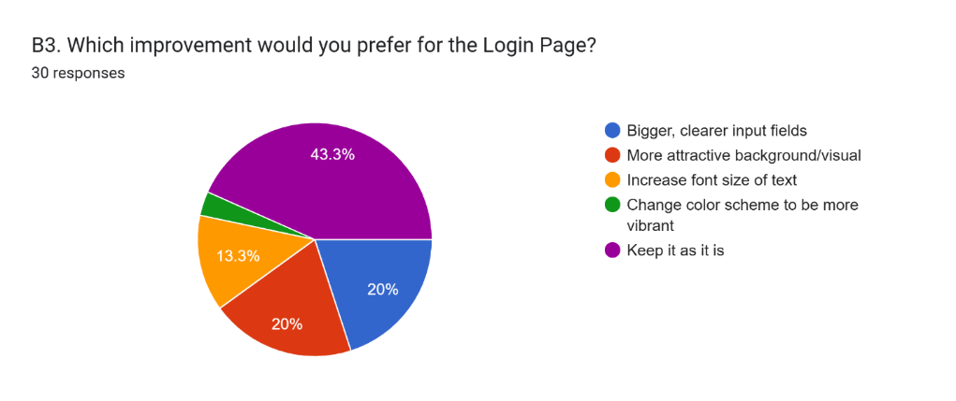
2.2.1 Login Page Analysis
• 13.3% Dissatisfied, 60% Neutral, 26.7% Satisfied
• 53.3% reported no problems
• 30% found page too plain
• 43.3% preferred to keep as-is
• Not a top candidate for redesign
6

Slide 7
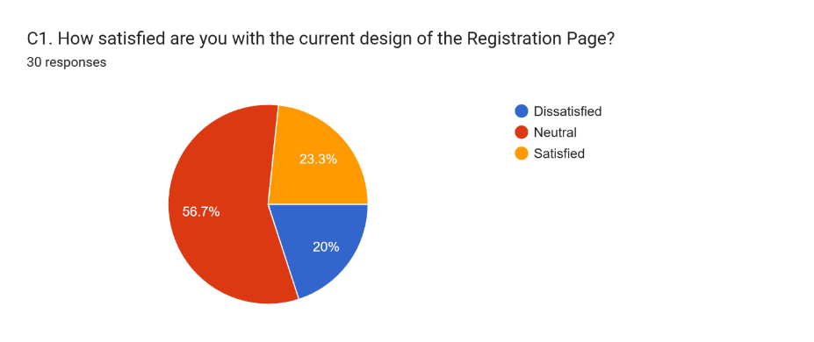
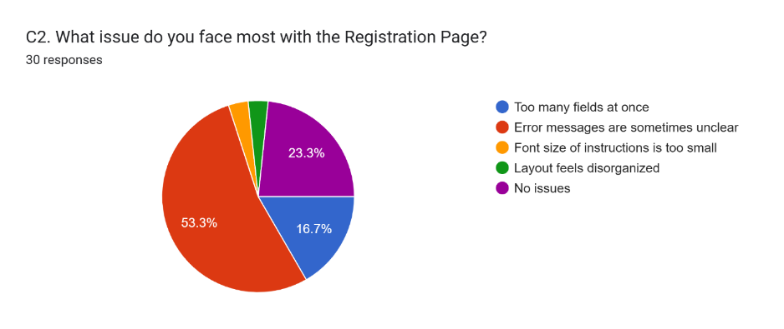
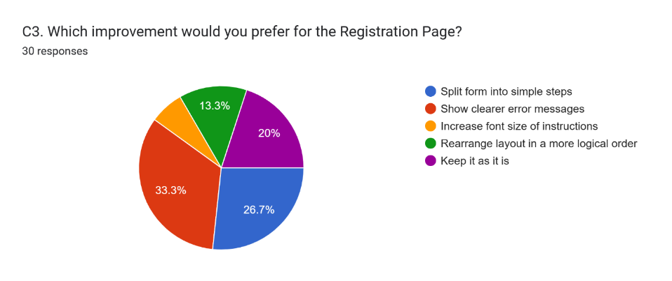
2.2.2 Registration Page Analysis
• 20% Dissatisfied, 56.7% Neutral, 23.3% Satisfied
• 53.3% reported unclear error messages
• 33.3% preferred clearer error messages
• Issue: Error handling, not layout
• Selected for redesign: Bold red error messages
7

Slide 8
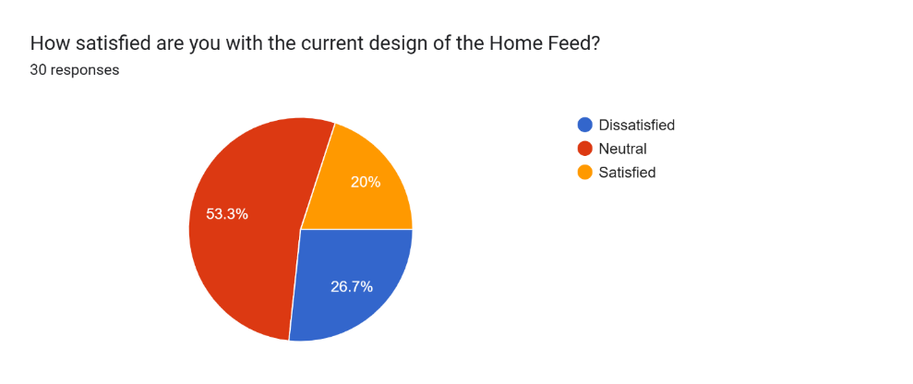
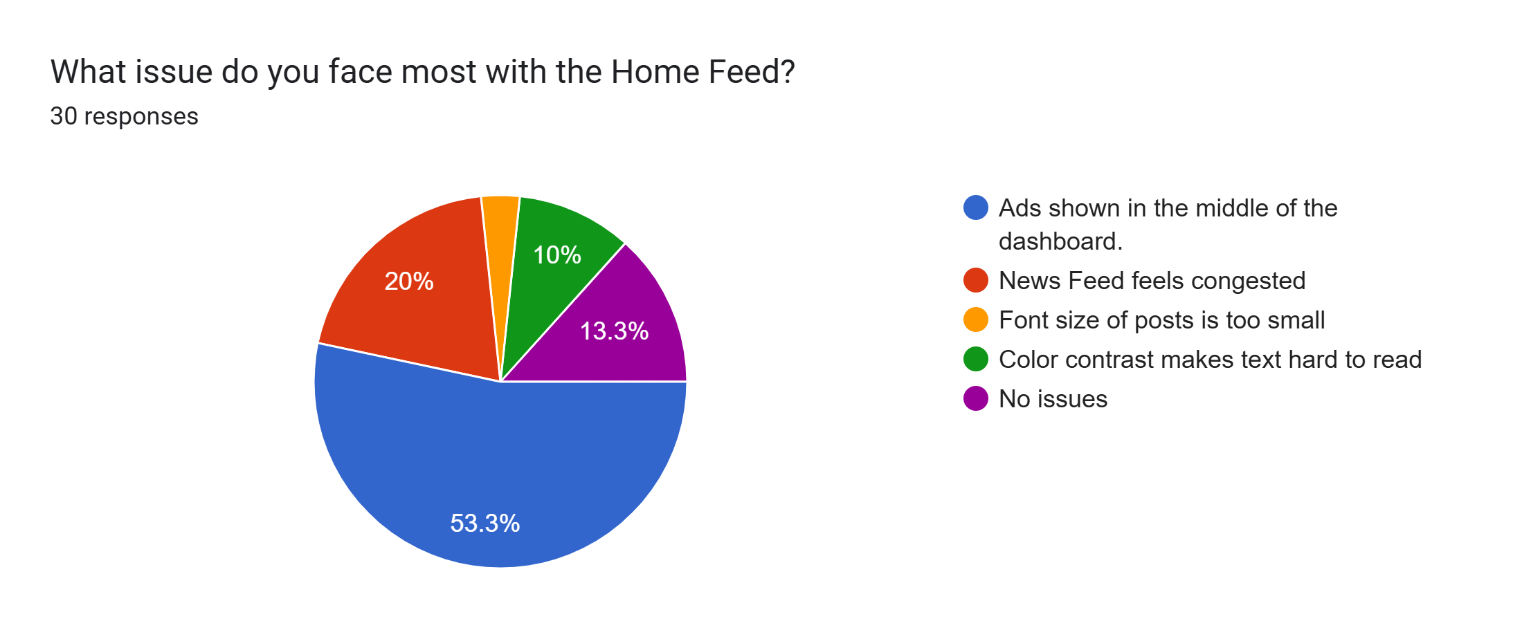
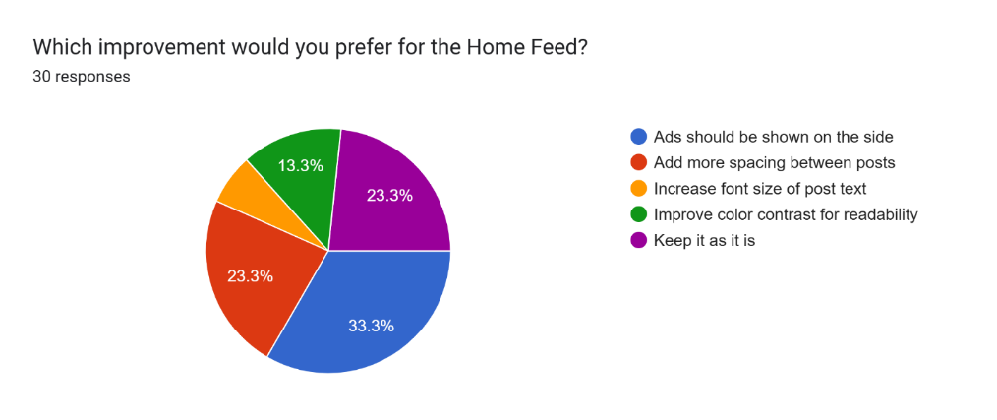
2.2.3 Home Feed (Dashboard) Analysis
• 26.7% Dissatisfied (highest), 53.3% Neutral, 20% Satisfied
• 53.3%: Ads disrupt browsing experience
• 33.3% preferred ads moved to side
• Strongest signal in entire survey
• Selected for redesign: Move ads to side panel
8

Slide 9
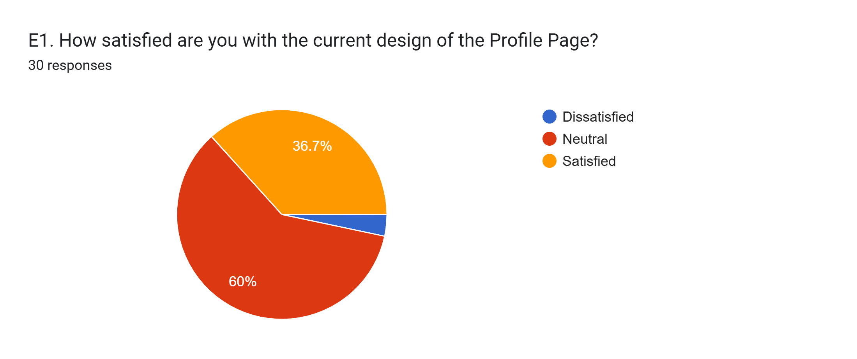
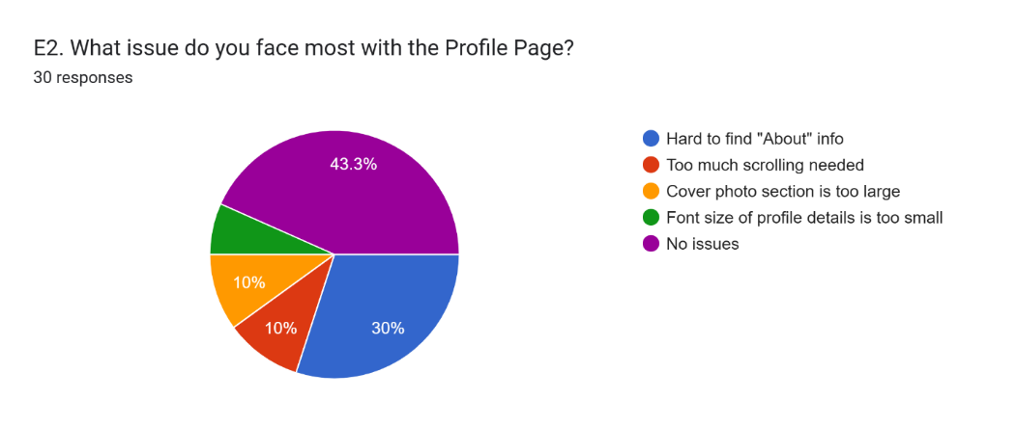
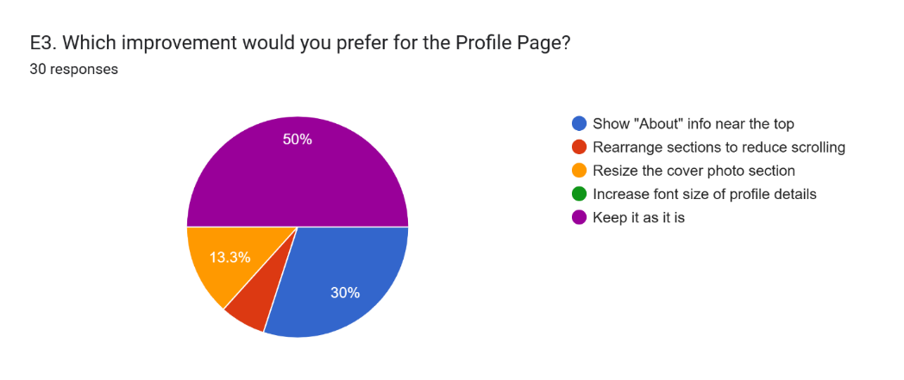
2.2.4 Profile Page Analysis
• 3.3% Dissatisfied, 60% Neutral, 36.7% Satisfied
• Highest satisfaction score in study
• 43.3% reported no problems
• 50% preferred to keep as-is
• Low priority for redesign – kept unchanged
9

Slide 10

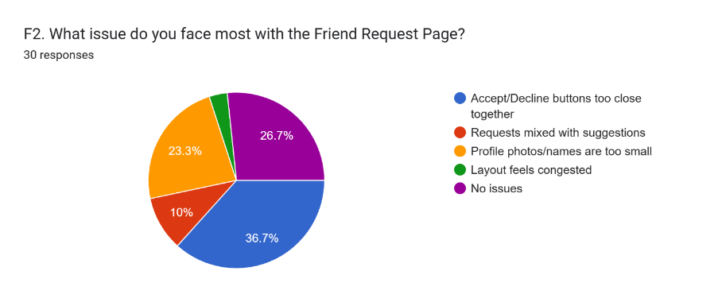
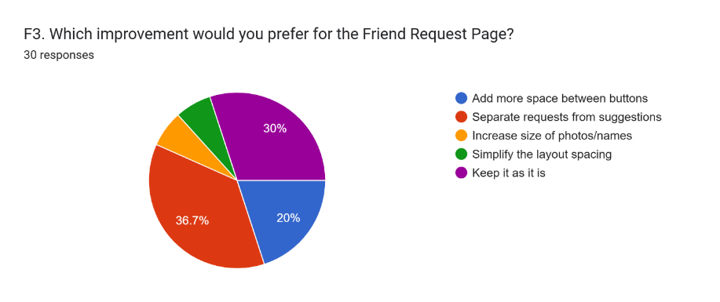
2.2.5 Friend Request Page Analysis
• 26.7% Dissatisfied, 53.3% Neutral, 20% Satisfied
• 37%: Accept/Decline buttons too close
• 10%: Requests mixed with suggestions
• 56.7% wanted spacing or separation
• Selected for redesign: Add spacing + separate sections
10

Slide 11
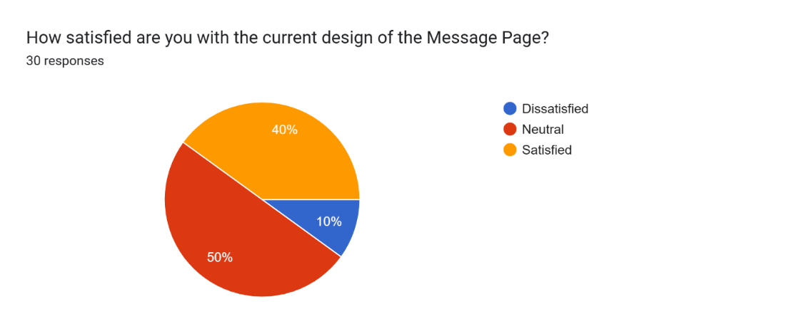
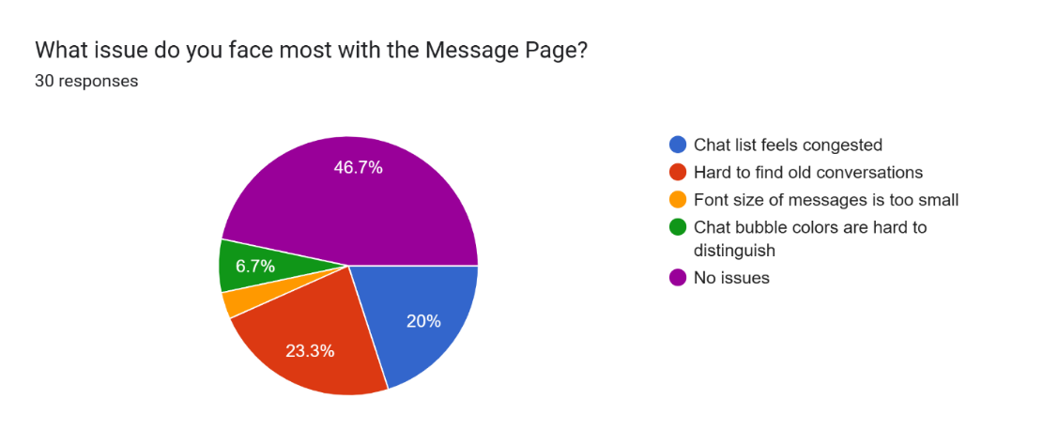
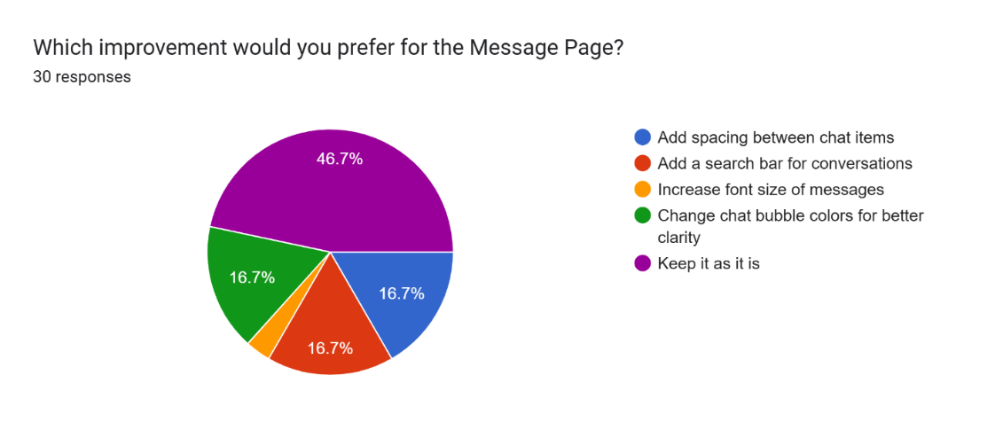
2.2.6 Message Page Analysis
• 10% Dissatisfied (lowest), 50% Neutral, 40% Satisfied
• Second highest satisfaction score
• 46.7% reported no problems
• Majority wanted design to stay as-is
• Not selected for redesign – kept unchanged
11

Slide 12

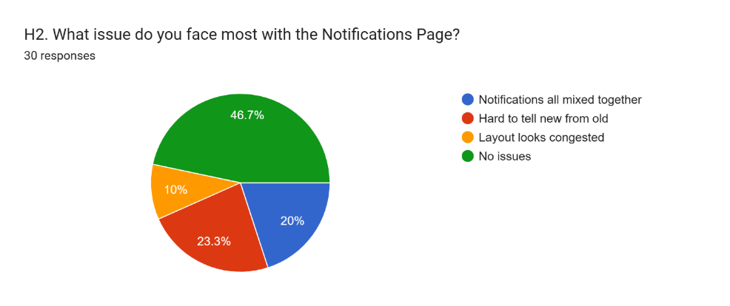
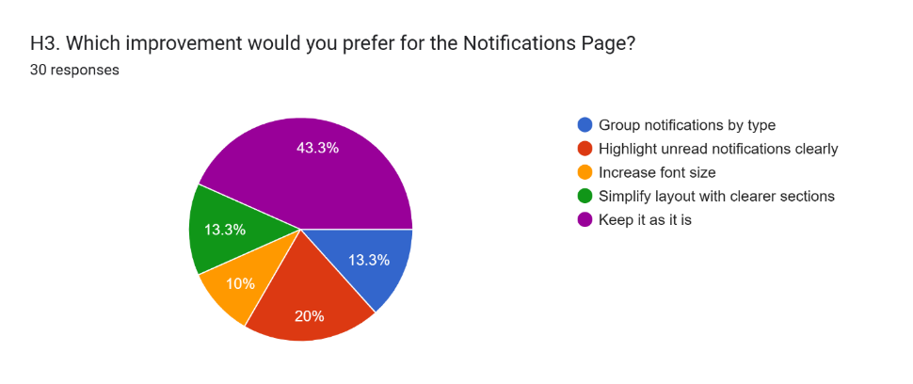
2.2.7 Notifications Page Analysis
• 10% Dissatisfied, 56.7% Neutral, 33.3% Satisfied
• 46.7% reported no problems
• 23.3%: Hard to tell new from old notifications
• 20.1% requested clearer unread indicators
• Selected for redesign: Add badges and visual indicators
12

Slide 13
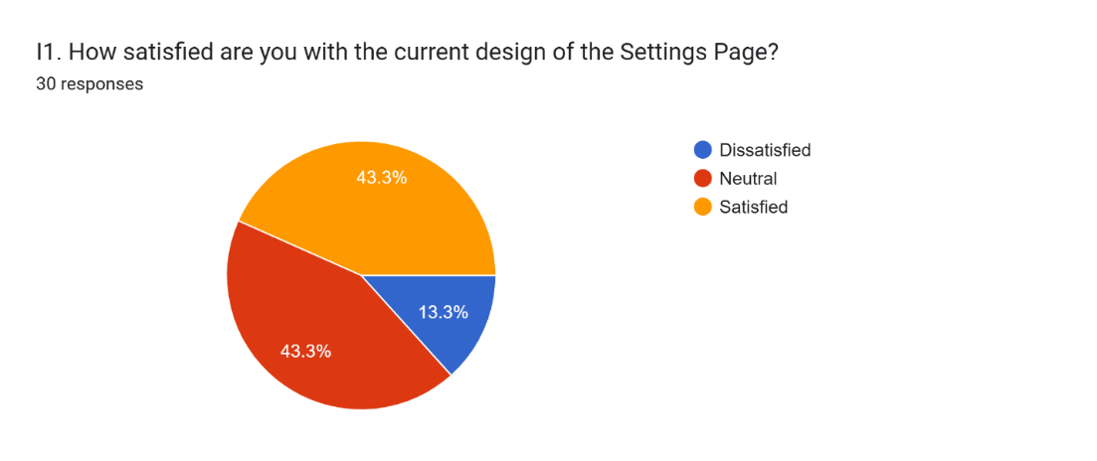
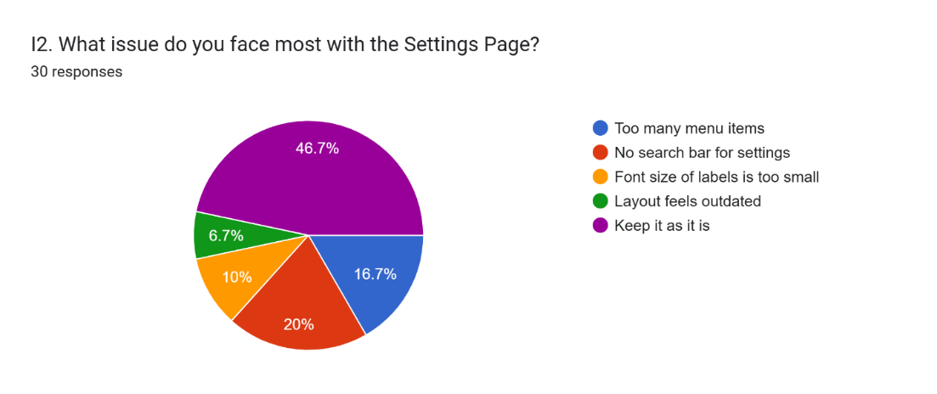
2.2.8 Settings Page Analysis
• 13.3% Dissatisfied, 43.3% Neutral, 43.3% Satisfied
• 46.7% reported no issues
• Balanced satisfaction scores
• Light dissatisfaction – not changed
• Kept unchanged in redesign
13

Slide 14
2.3 Hypothesis Formulation – Four Pain Points
Pain Point 1: Home Feed Ads
Pain Point 2: Friend Request Actions
Main use: Surfing & reading news
Moving ads to side will positively affect satisfaction by reducing interruption
Main use: Social connection management
More spacing + separating requests from suggestions reduces accidental clicks
Pain Point 3: Unclear Registration Errors
Pain Point 4: Unread Notifications
Main use: Account creation/onboarding
Bold red error messages next to fields help users correct errors faster
Main use: Activity tracking
Badges and visual cues for unread items improve notification awareness
14

Slide 15
3.0 Interaction Design
• Redesign based on Section 2.0 UX Research results
• Designed in Figma prototype
• Four pages redesigned: Home Feed, Registration, Friend Request, Notifications
• Five pages kept unchanged: Login, Profile, Message, Settings, Create Post
• Navigation: Hub-and-spokes model – all pages one click from Home Feed
• Content Delivery: Card-based feed structure retained
• Ads moved to separate side column
• Friend Requests and People You May Know now in distinct lists
15

Slide 16
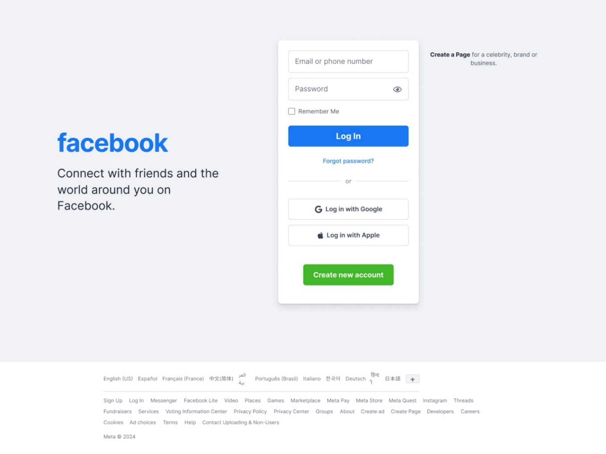
3.1 Prototype – Login Page (Unchanged)
Figure 25: Login Page (unchanged from default)
16

Slide 17
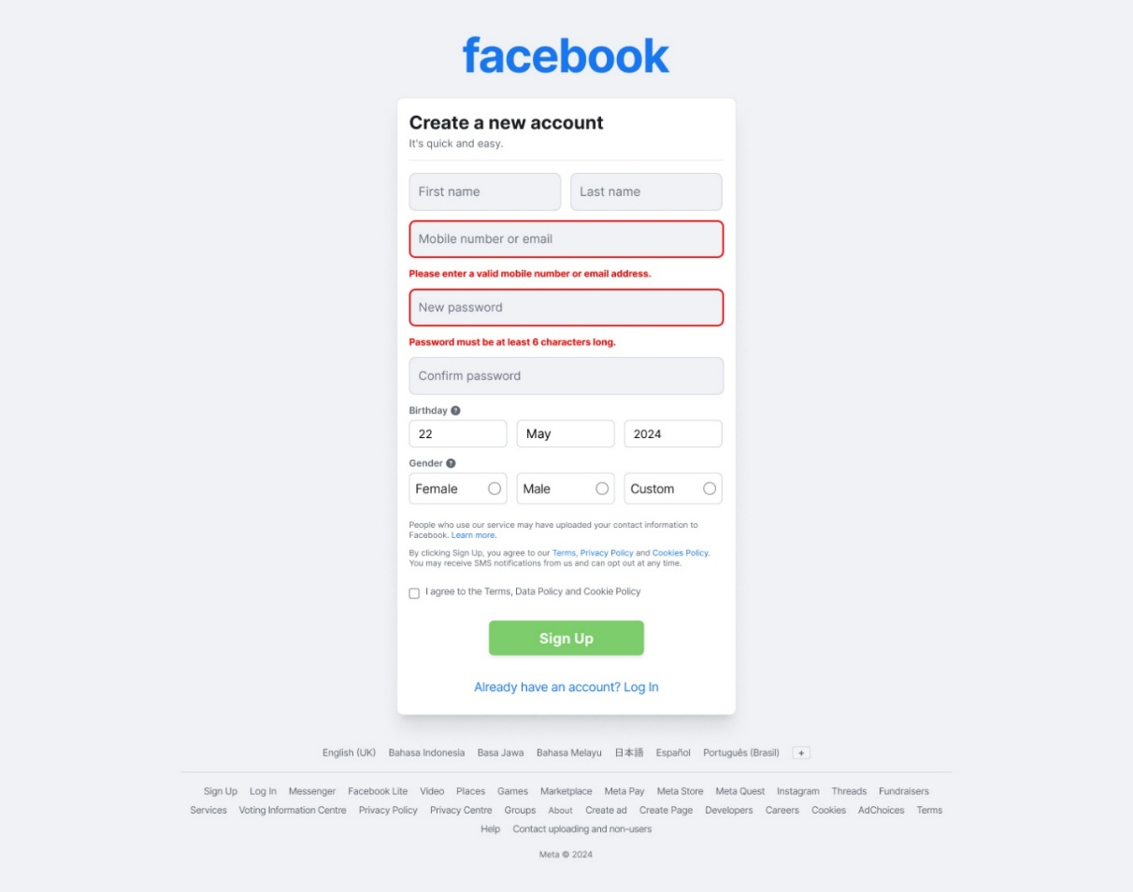
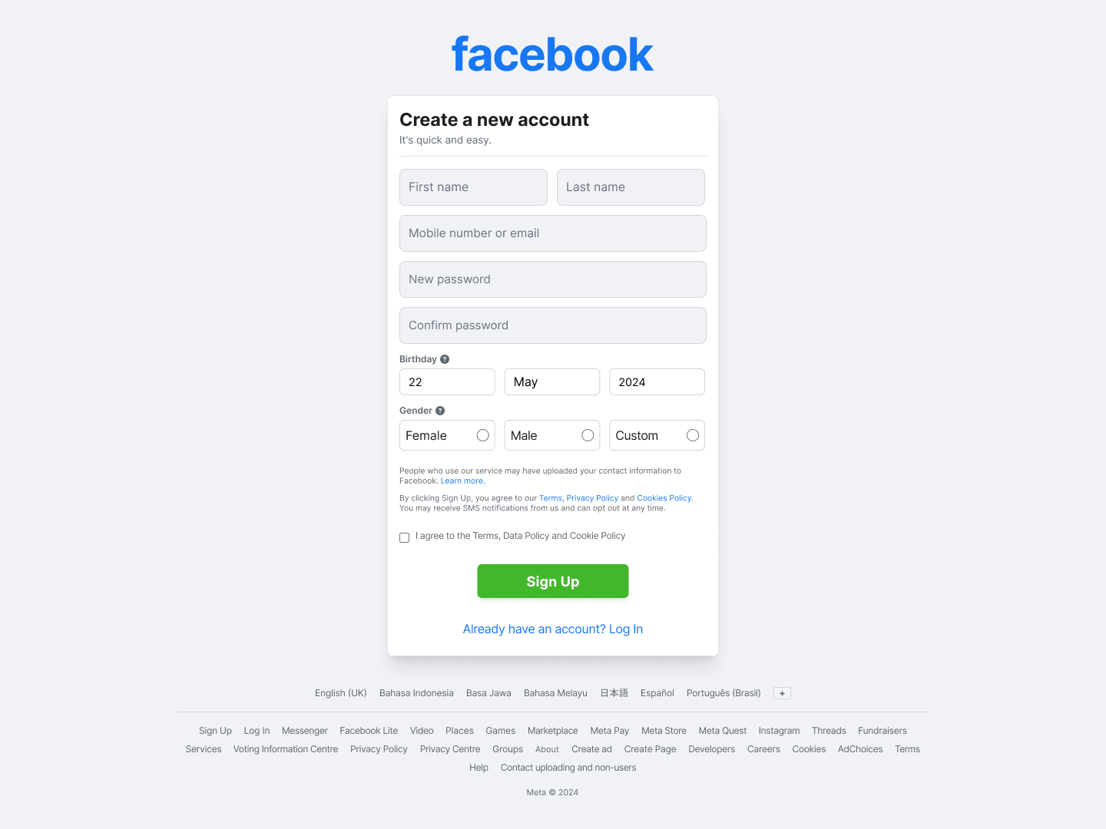
3.1 Prototype – Registration Page (Default vs Redesigned)
Figure 26(a): Default Registration
Figure 26(b): Redesigned – Bold Red Error Messages
17

Slide 18
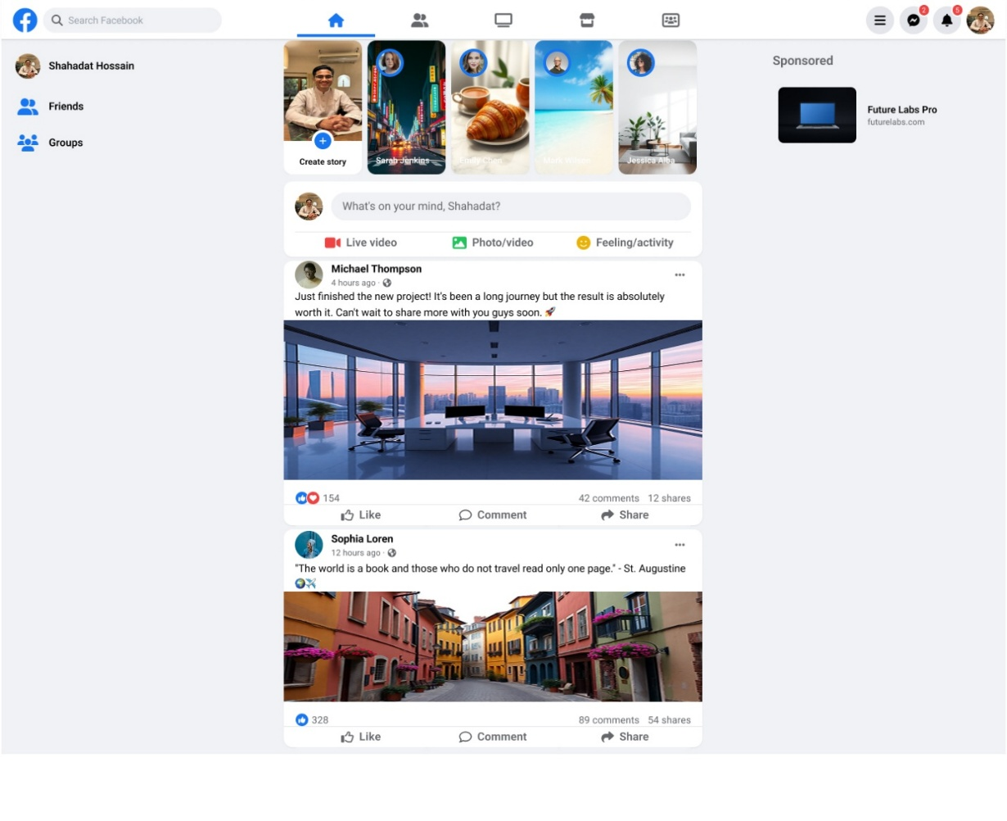
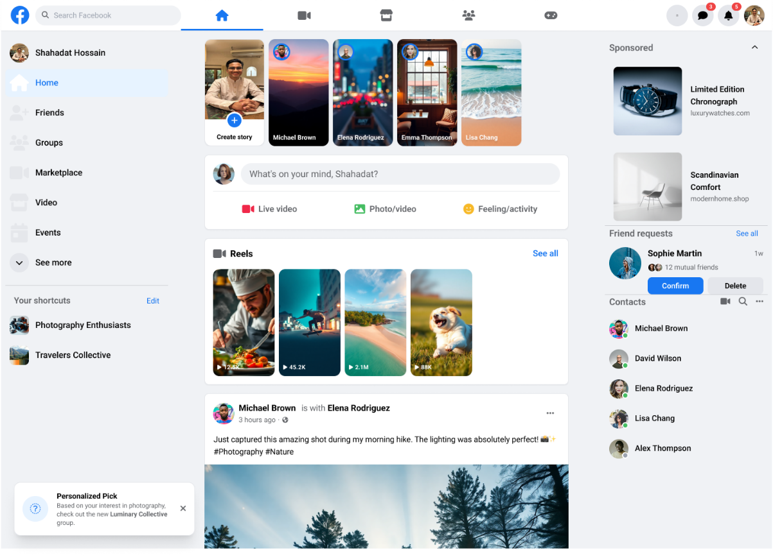
3.1 Prototype – Home Feed / Dashboard (Default vs Redesigned)
Figure 27(a): Default Home Feed
Figure 27(b): Redesigned – Ads Moved to Side
18

Slide 19
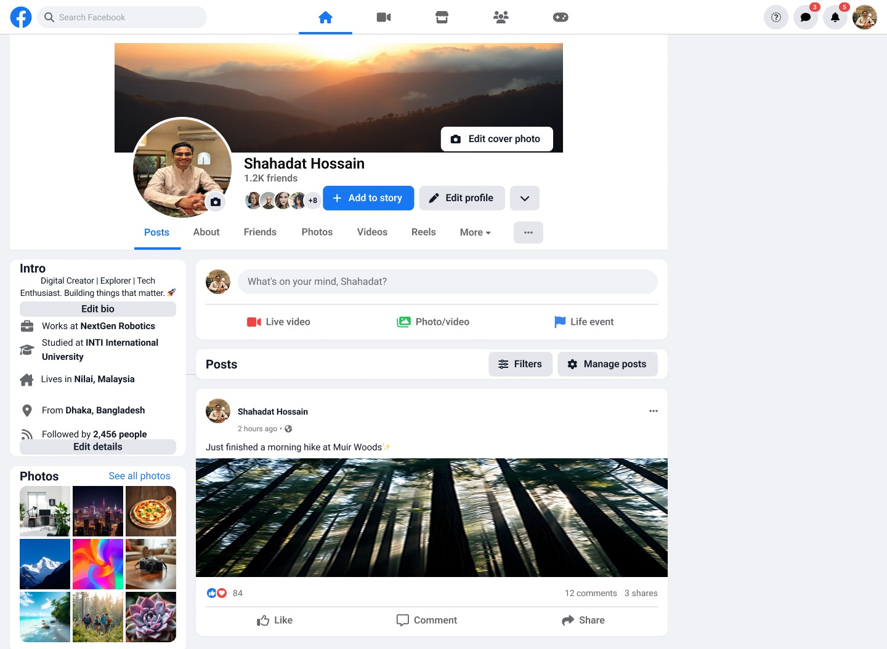
3.1 Prototype – Profile Page (Unchanged)
Figure 28: Profile Page (unchanged – highest satisfaction)
19

Slide 20
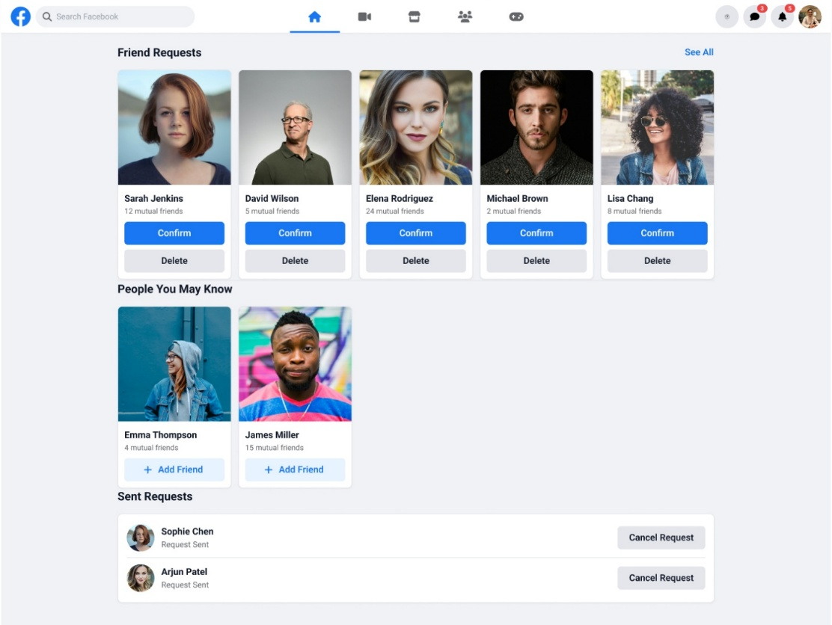
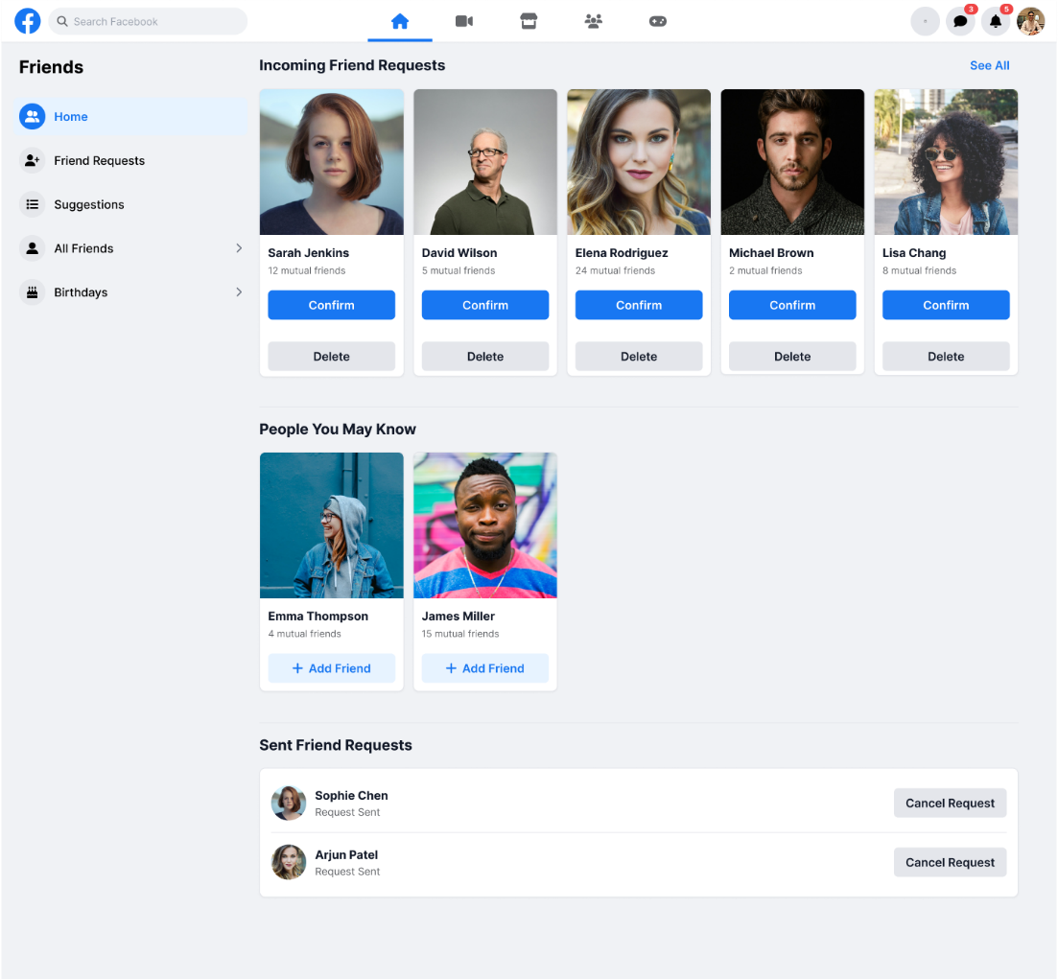
3.1 Prototype – Friend Request Page (Default vs Redesigned)
Figure 29(a): Default Friend Request
Figure 29(b): Redesigned – Spacing + Separated Suggestions
20

Slide 21
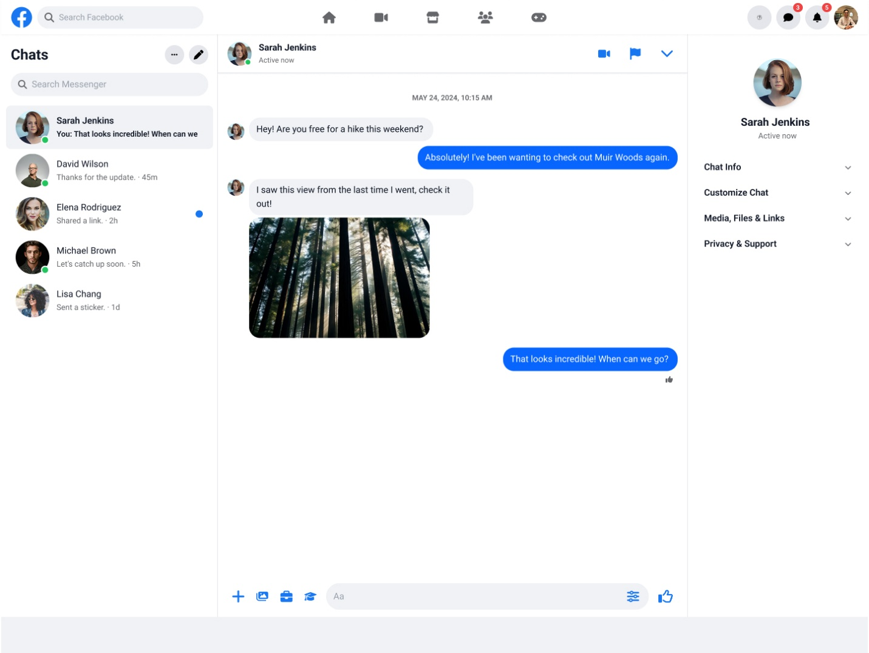
3.1 Prototype – Message Page (Unchanged)
Figure 30: Message Page (unchanged – lowest dissatisfaction)
21

Slide 22
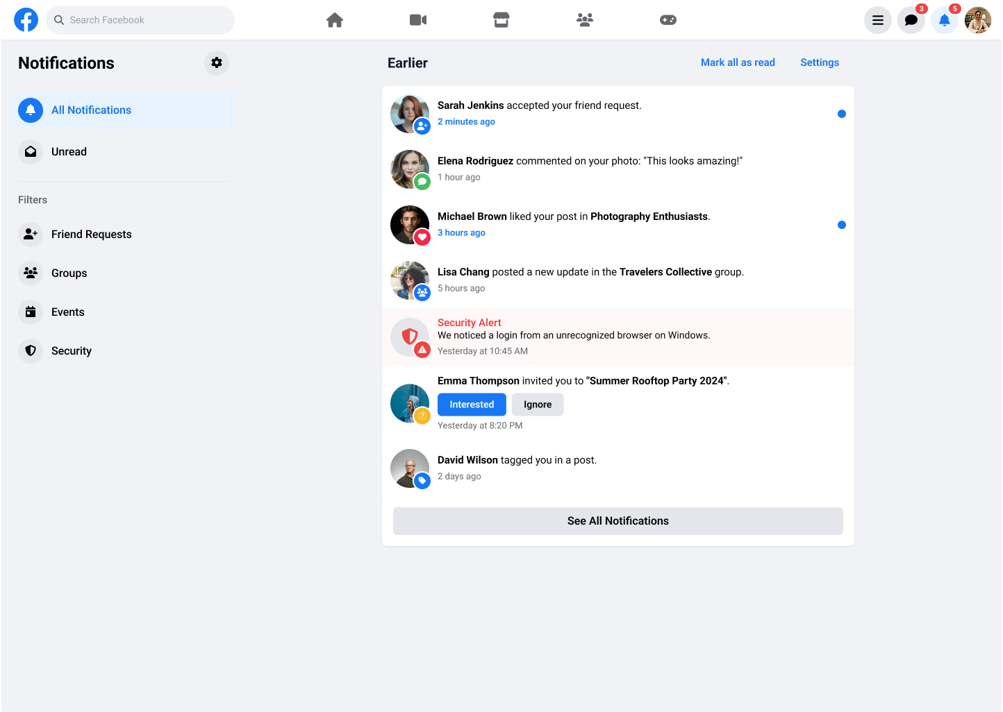
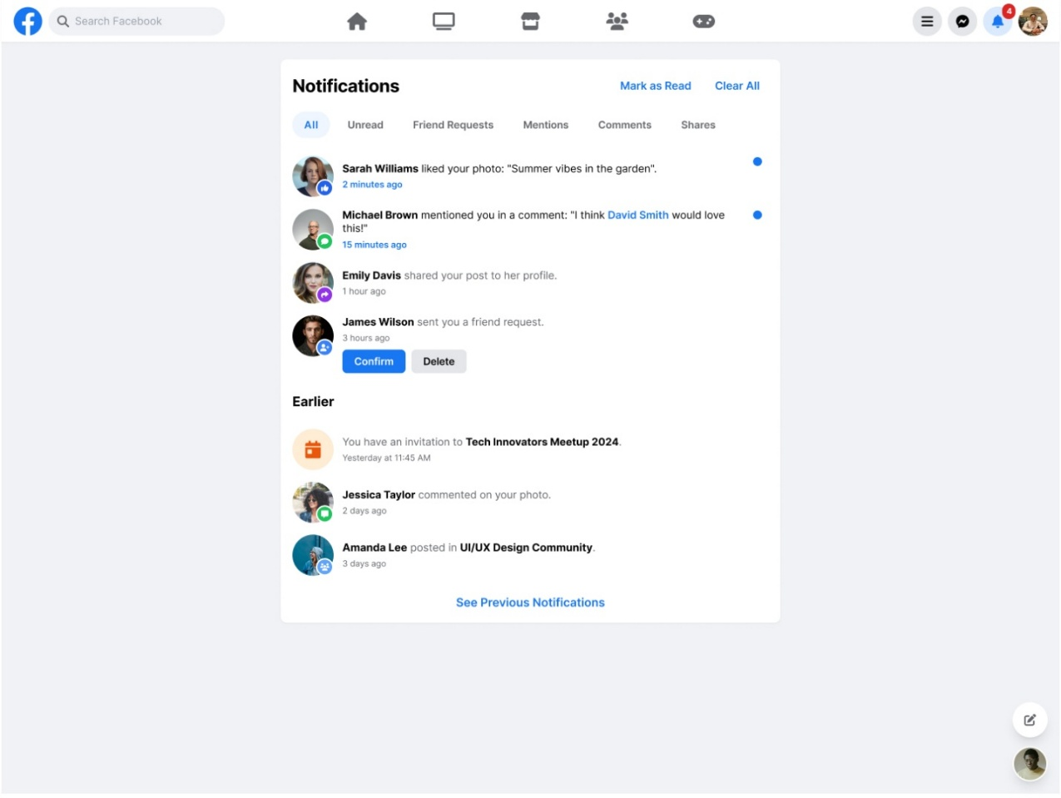
3.1 Prototype – Notifications Page (Default vs Redesigned)
Figure 31(a): Default Notifications
Figure 31(b): Redesigned – Badges & Visual Indicators
22

Slide 23
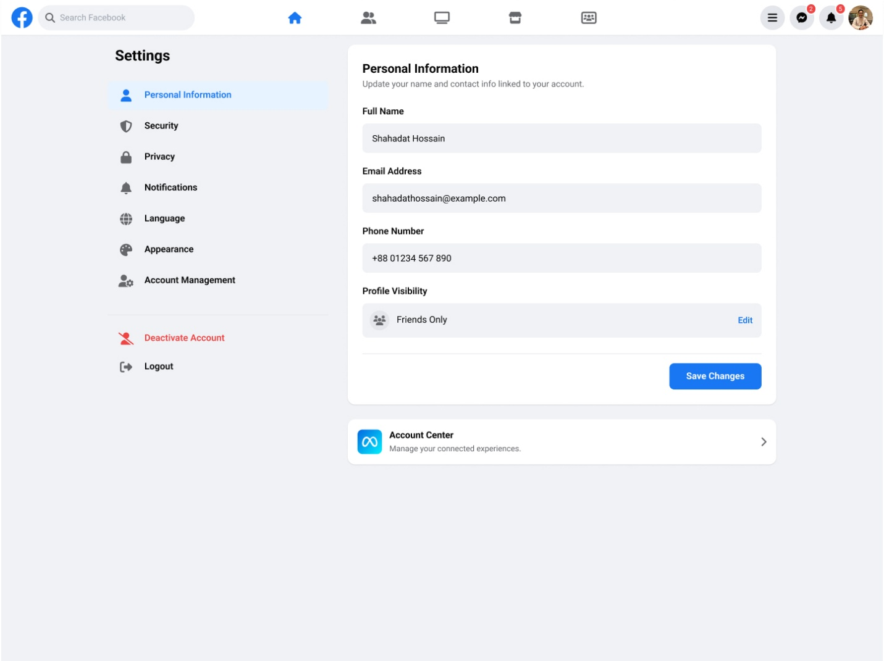
3.1 Prototype – Settings Page (Unchanged)
Figure 32: Settings Page (unchanged)
23

Slide 24
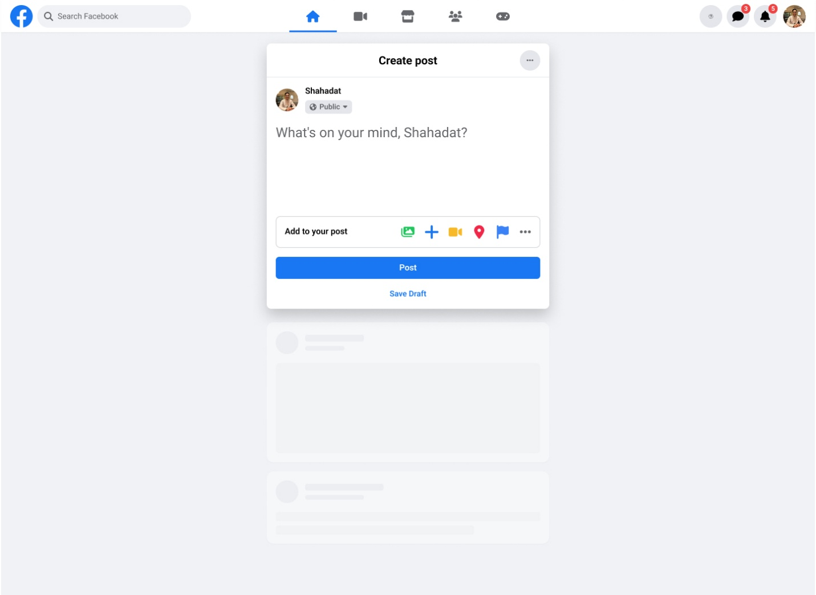
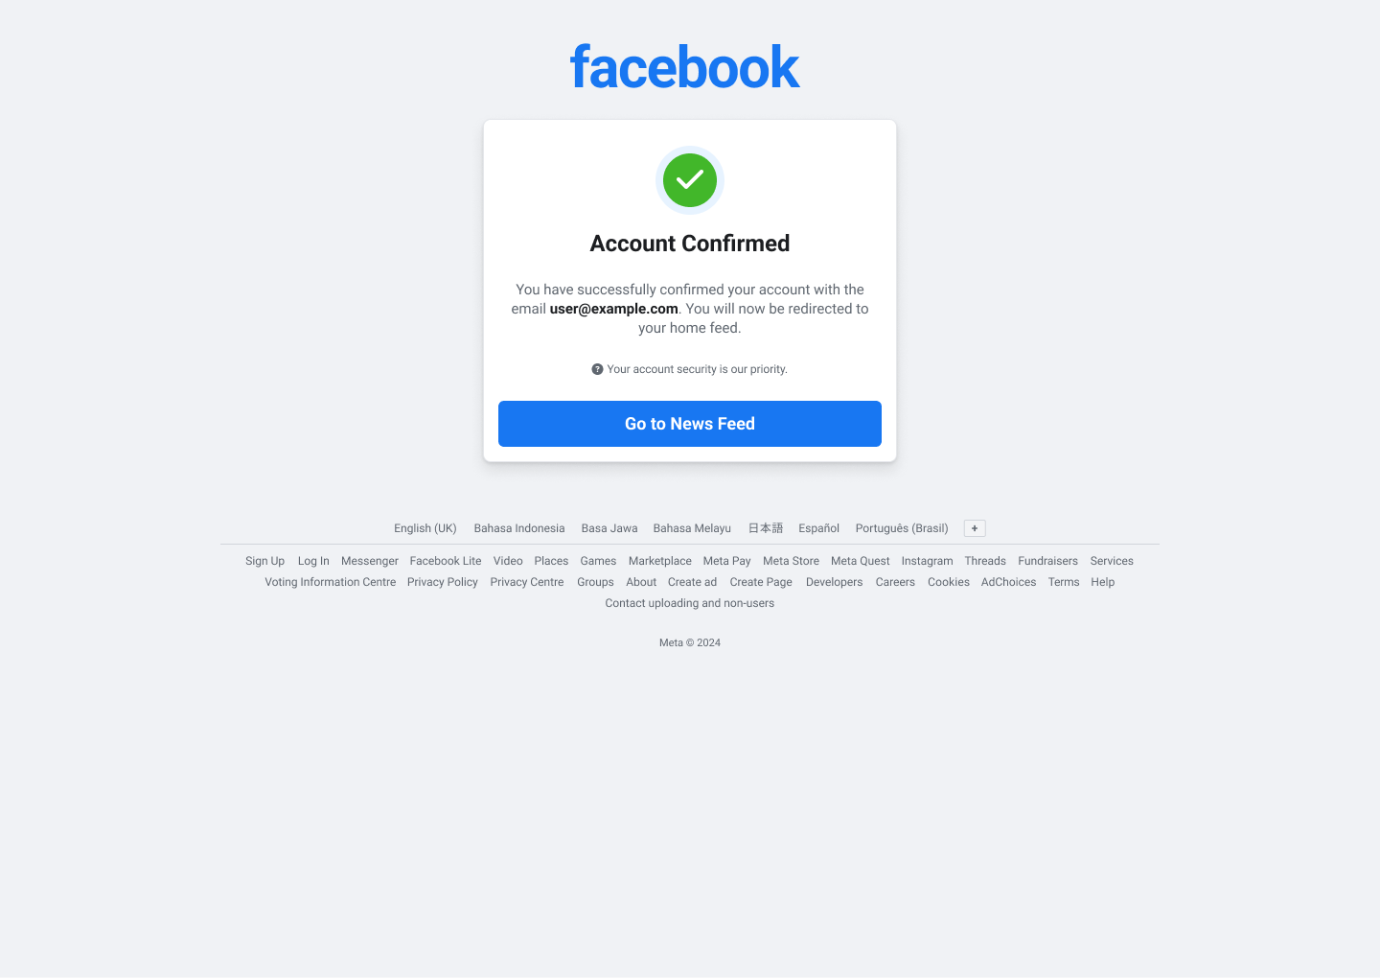
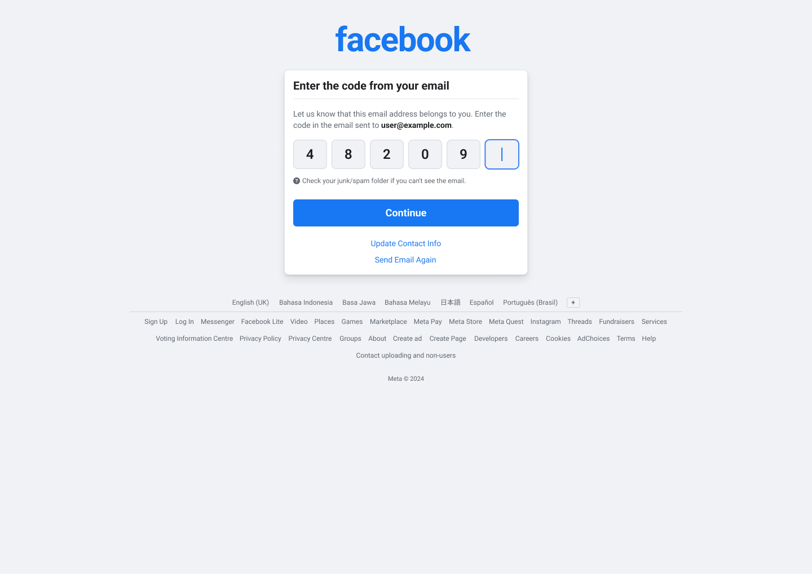
3.1 Prototype – Create Post, Verification & Confirmation Pages
Fig 33: Create Post
Fig 34: Verification
Fig 35: Confirmation
Figma Project URL: https://www.figma.com/design/tw2N4MICB6PatYu2xUMqnl/HCI-Facebook-UI
24

Slide 25
3.2 Content Delivery & 3.3 Interactive Features
3.2 Content Delivery – Conceptual Design
• Card-based feed structure retained
• Sponsored content (ads) in separate side column
• Friend Requests and People You May Know in distinct lists
• Each list has its own title header
• Hub-and-spokes navigation: all pages one click from Home Feed
3.3 Interactive Features
• Real-time bold red error messages under input fields (Registration)
• Hover and click states on Accept/Decline buttons (Friend Request)
• Collapsible side panel for ads (Home Feed)
• Notification badges showing unread count
• Visual markers (bold text, color highlight, dot marker) for unread notifications
25

Slide 26
4.0 Usability Testing
• Same 30 respondents from original survey
• Same structured close-ended questionnaire method
• Consistency allows before/after comparison
• Only 4 redesigned pages tested: Home Feed, Registration, Friend Request, Notifications
• 1–5 rating scale (more granular than original)
• Ratings between 4.03 and 4.68 out of 5
• All 4 pages showed high preference for new design
26

Slide 27
4.1 Participants & 4.2 Survey Scope and Results
4.1 Participants
• All 30 original respondents invited
• Same participant pool ensures valid comparison
• Wide and representative group of real users
• More indicative than limited face-to-face tests
4.2 Survey Scope & Results
• 4 redesigned pages tested
• Home Feed: Ads moved to side
• Registration: Clearer red error messages
• Friend Request: Spacing + separated suggestions
• Notifications: Badges & visual indicators
• Ratings: 4.03 to 4.68 out of 5
• All pages showed high preference for new design
27

Slide 28
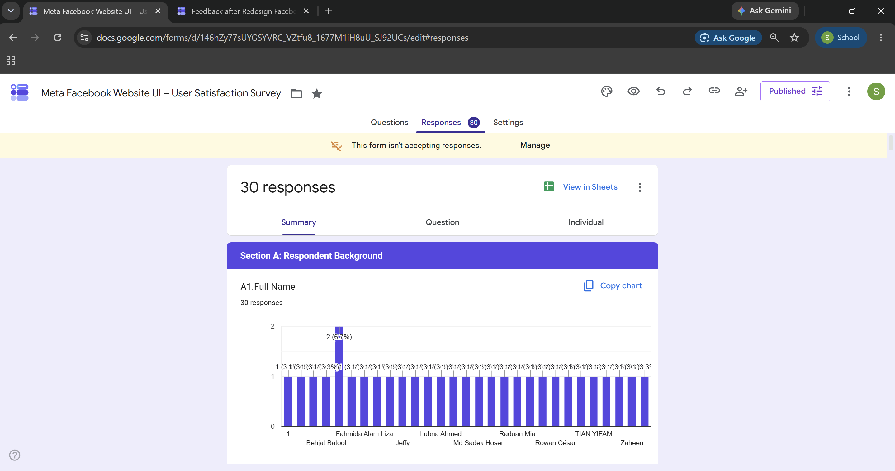
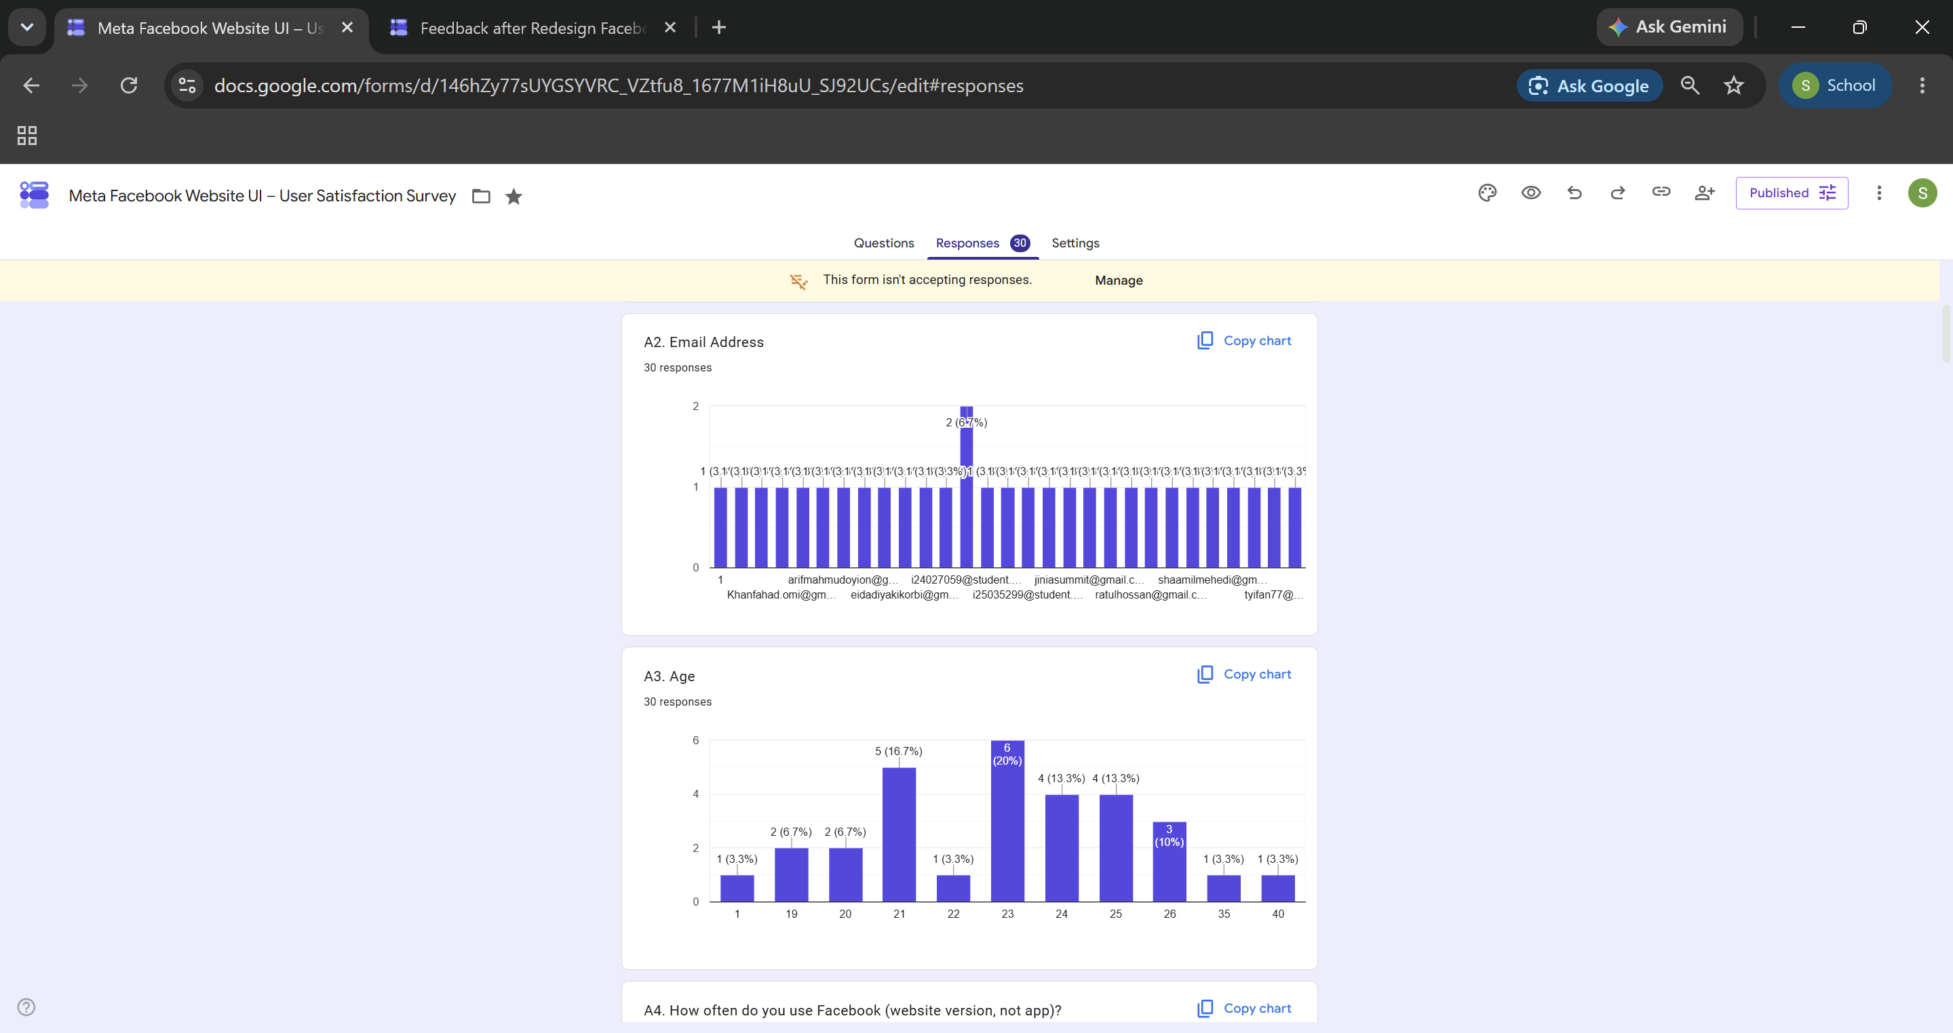
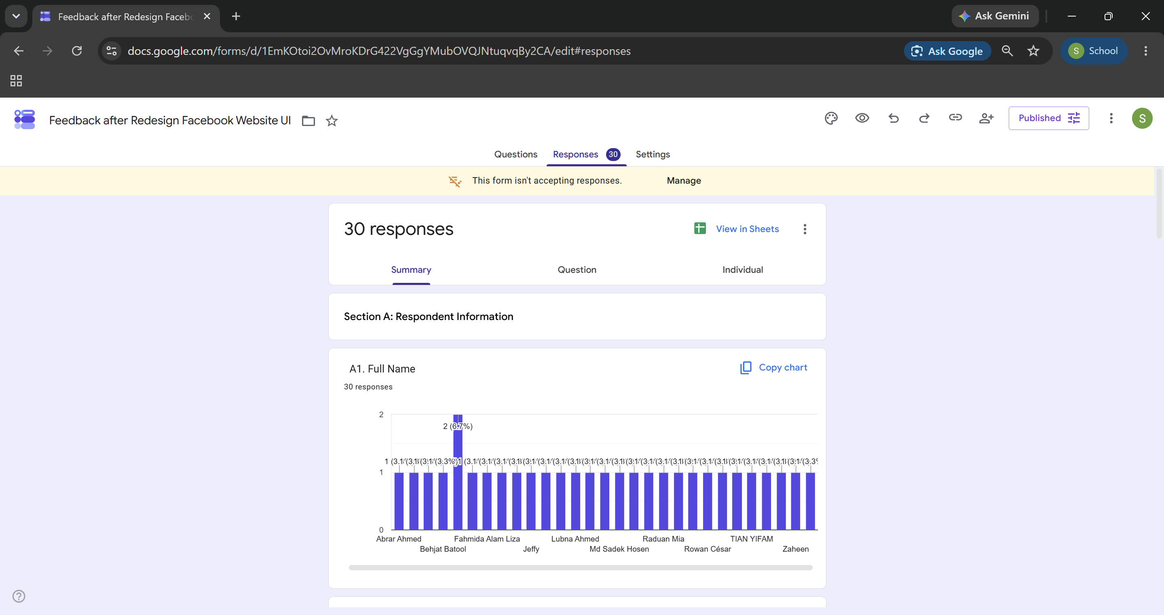
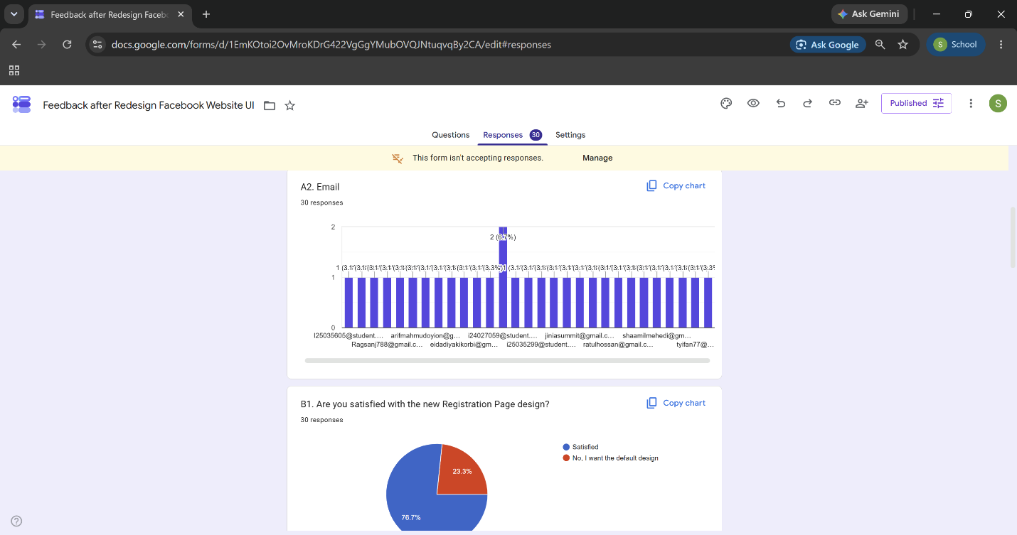
4.3 Evidence of Conduct – Google Forms Response Summaries
Evidence 1: Follow-up Form
Evidence 2: Follow-up Form (cont.)
Evidence 3: Prototype Feedback
Evidence 4: Prototype Feedback (cont.)
28

Slide 29
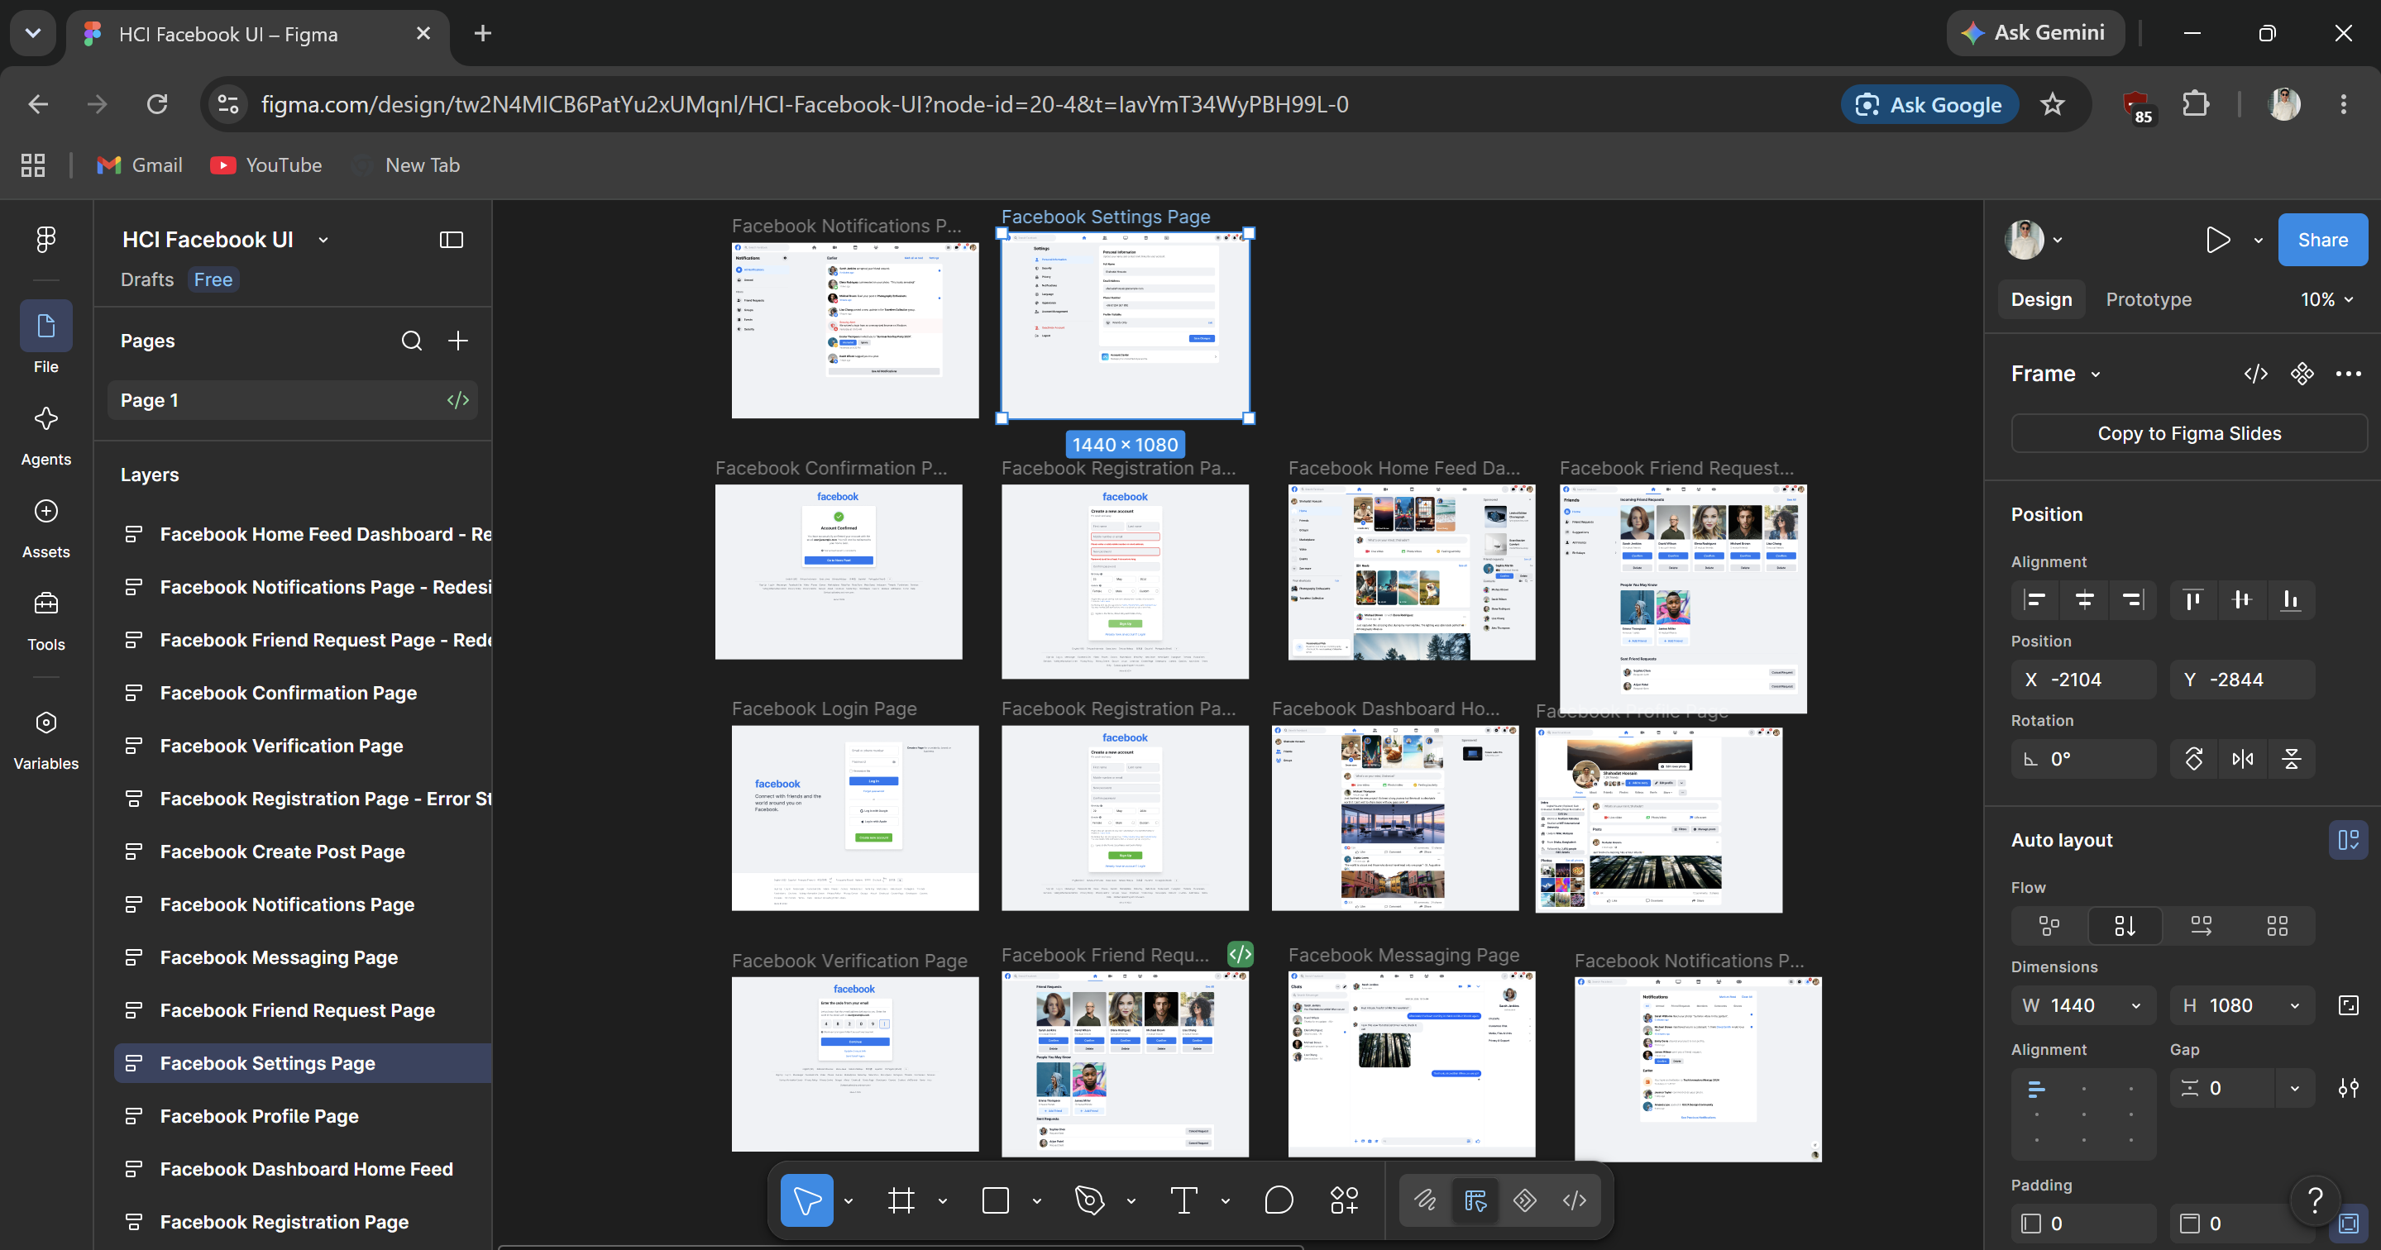
4.3 Evidence of Conduct – Figma Prototype Designs
Figure 44: Screenshot of all Figma prototype designs (default and redesigned versions)
29

Slide 30
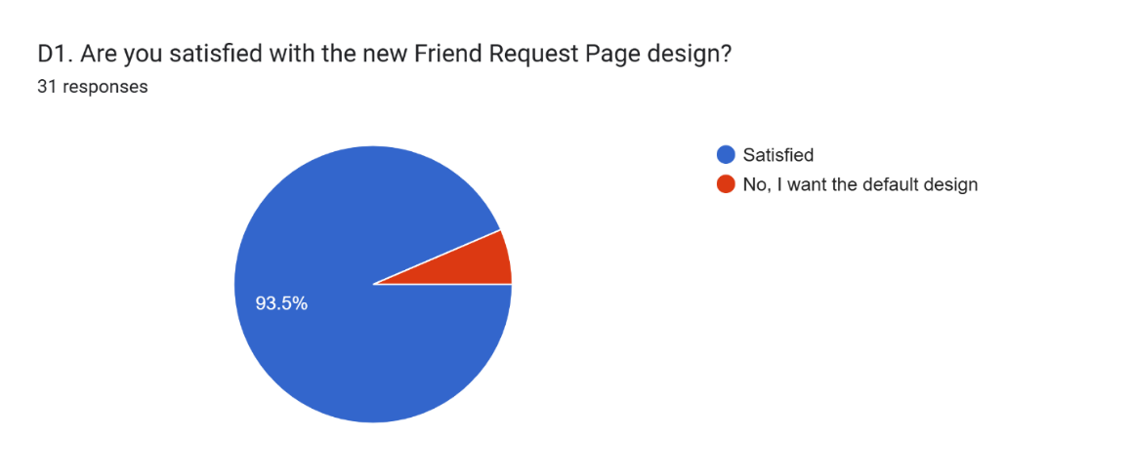
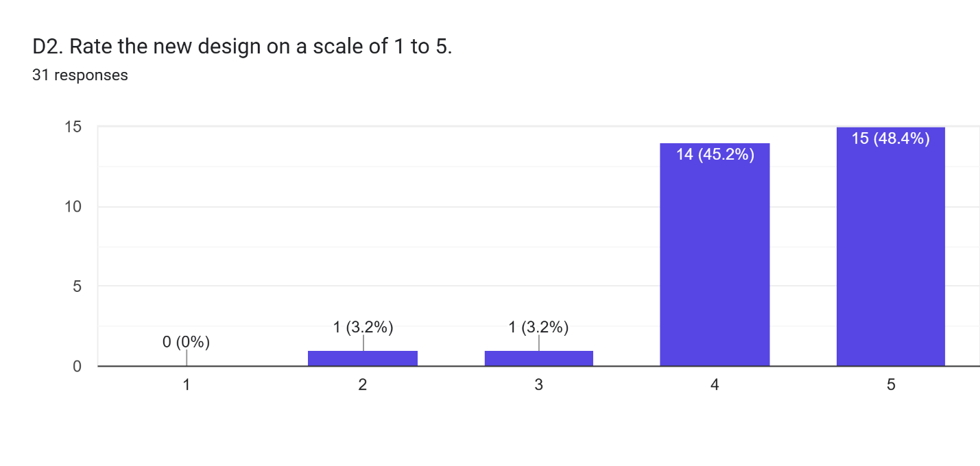
Section B: Friend Request Page – Usability & Visual Design
• 93.7% satisfied with redesigned navigation (29 of 31)
• Highest average rating: 4.39 out of 5
• 93.6% rated 4 or 5 stars
• More spacing reduced hesitation and mistakes
• Directly solved Pain Point 2 from Section 2.3
Fig 36: Satisfaction vs Default`
Fig 37: Rating Distribution (1-5)
30

Slide 31
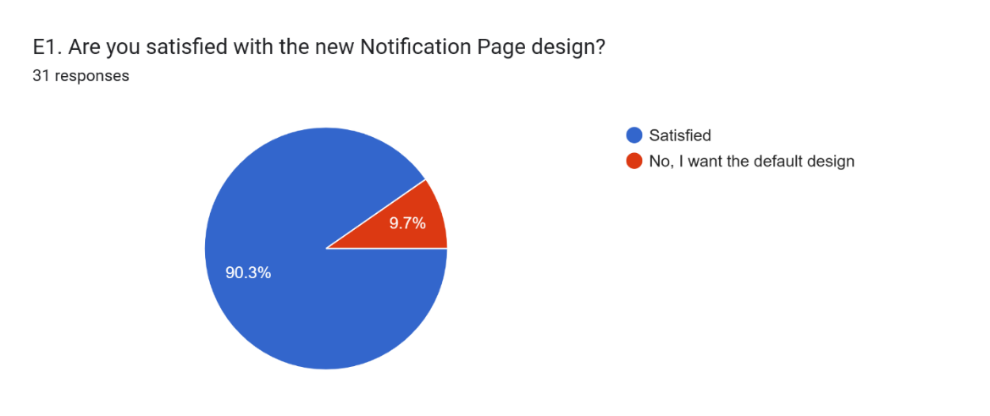
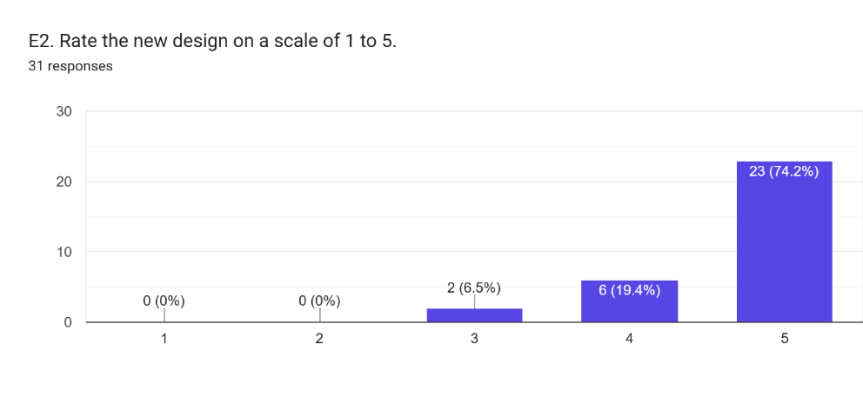
Section B: Notifications Page – Usability & Visual Design
• 93.5% satisfied with new design (28 of 31)
• Highest rating of all redesigned pages: 4.68 out of 5
• 74.2% rated 5 stars
• Visual cues and badges made notifications easier to track
• Solved Pain Point 4 from Section 2.3
Fig 38: Satisfaction vs Default
Fig 39: Rating Distribution (1-5)
31

Slide 32
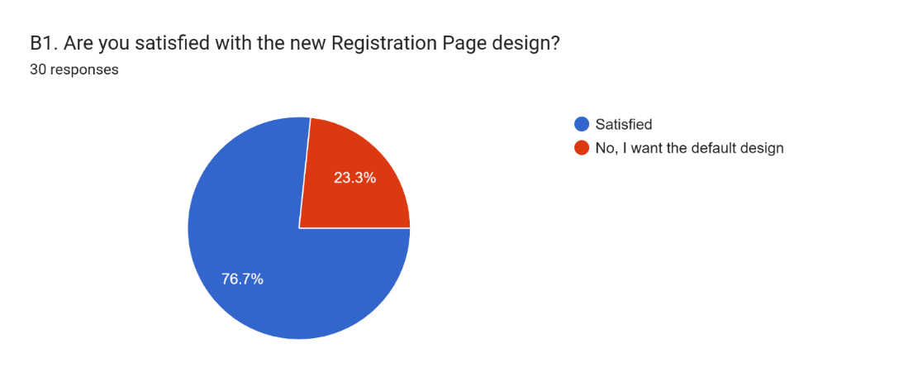
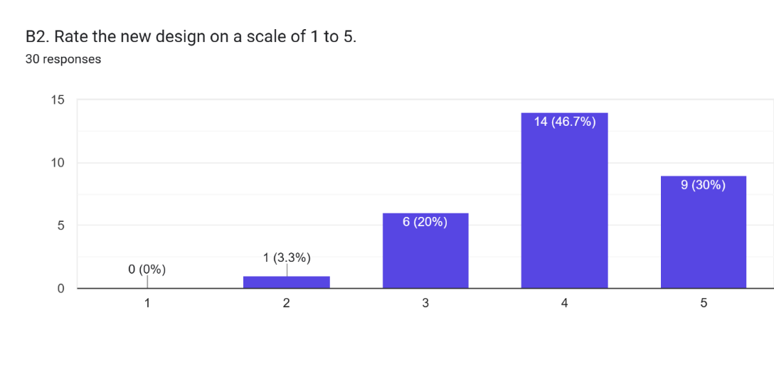
Section B: Registration Page – Layout & Performance
• 76.7% satisfied with new design (23 of 30)
• Average rating: 4.03 out of 5
• 23.3% preferred original format
• Bold red error messages improved clarity
• Solved Pain Point 3 from Section 2.3
Fig 40: Satisfaction vs Default
Fig 41: Rating Distribution (1-5)
32

Slide 33
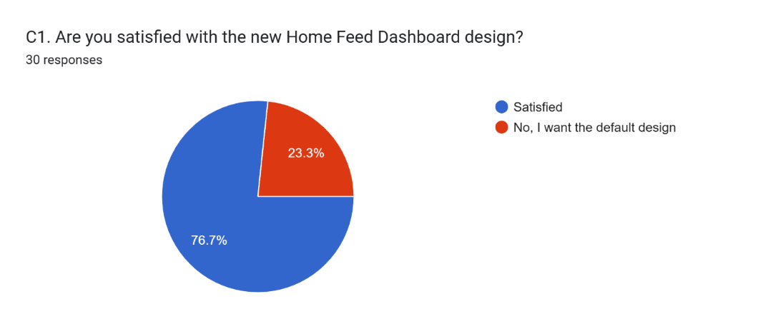
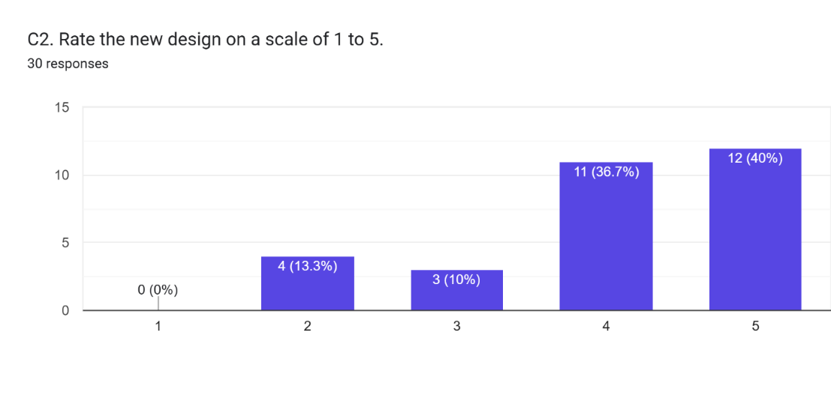
Section B: Home Feed – Layout & Performance
• 76.7% satisfied with new design (23 of 30)
• Average rating: 4.03 out of 5
• 23.3% preferred original format
• Moving ads to side improved page for many
• Some gave 2-star rating (13.3%) – diverse opinions
• Solved Pain Point 1 from Section 2.3
Fig 42: Satisfaction vs Default
Fig 43: Rating Distribution (1-5)
33

Slide 34
Conclusion
• 30-person survey revealed 4 key pain points: Home Feed ads, Registration errors, Friend Request buttons, Notification clarity
• 4 pages redesigned in Figma based on data-driven user feedback
• 5 pages kept unchanged to avoid unnecessary changes
• Follow-up survey: 93.7% satisfaction with new designs
• Average ratings: 4.03 to 4.68 out of 5
• Notifications Page (4.68/5) and Friend Request Page (4.39/5) performed best
• No 1-star reviews on any redesigned page
• User-centered design works: minimal, evidence-based changes yield significant satisfaction gains
34

Slide 35
References
1. Shahadat Hossain. (2026). Facebook website UI redesign prototype [Figma design file]. https://www.figma.com/design/tw2N4MICB6PatYu2xUMqnl/HCI-Facebook-UI
2. Primary research data: Facebook Website UI User Satisfaction Survey, self-administered via Google Forms, 30 respondents (2026). https://forms.gle/L8tZaVzR3C7FEwta7
3. Primary research data: Facebook Website UI Redesign Feedback Survey for usability testing, self-administered via Google Forms, 30 respondents (2026). https://forms.gle/uhifUUYMqAPaEzxk7
4. DataReportal. (2025). Facebook users, stats, data, trends, and more. https://datareportal.com/essential-facebook-stats
5. Nielsen Norman Group. (2024a, February 2). Why you only need to test with 5 users. https://www.nngroup.com/articles/why-you-only-need-to-test-with-5-users/
6. Nielsen Norman Group. (2024b, January 16). Why personas fail. https://www.nngroup.com/articles/why-personas-fail/
7. Nielsen Norman Group. (2024c, July 24). Qualitative usability testing: Study guide. https://www.nngroup.com/articles/qual-usability-testing-study-guide/
35

Slide 36
Thank You
Shahadat Hossain | I26041279 | HCI3202 Human Computer Interface
36

